Slide 1
TK2100: Informasjonssikkerhet Lesson 09: HTTPS and Sessions
Dr. Andrea Arcuri
Westerdals Oslo ACT
University of Luxembourg

Slide 2
Goals
Understand the bases of HTTPS, and why it should always be used instead of HTTP
Understand the bases of HTTP Cookies and handling of sessions in HTTP/S
Learn how to carry out cross-site request attacks

Slide 3
HTTPS

Slide 4
HTTP is Not Secure
Messages in HTTP are not secure, because not encrypted
HTTPS extends HTTP by using encryption on all messages
Important to do for ALL kinds of communications, even if not critical
Not just for authentication (login) in banks or other internet services
Example, ISPs (eg Comcast) can inject ads in web pages
ISP -> Internet Service Provider

Slide 5

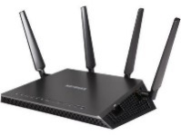
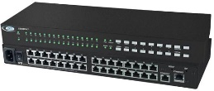

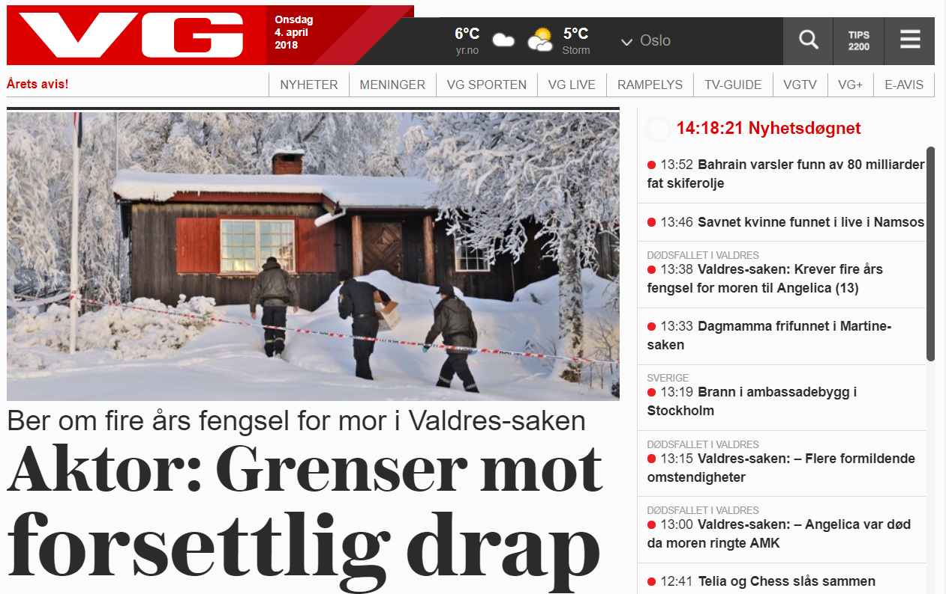
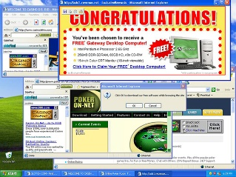
What would be the point of encrypting pages of a newspaper?
If not encrypted (ie HTTP instead of HTTPS) anyone between you and the target server can alter the payload of the messages…
HTTP: GET vg.no
Home WiFi
Your ISP
HTML of vg.no
Vg.no
Your Computer
Modified HTML
Modify the HTML payload content of the HTTP response, eg, by injecting ads

Slide 6
TLS/SSL Digital Certificates
When using HTTPS to a server, first download a digital certificate
Digital Certificate (DC) contains:
domain name (eg. www.facebook.com)
trusted certificate authority (CA)
server's public encryption key, ie RSA algorithm
Certificates have expiration time
The certificates themselves are signed, with the OS having public keys to check their integrity , ie they are signed with the private keys of the CA

Slide 7
Cont.
Eve would not be able to forge a DC for www.facebook.com (eg needed for her phishing attacks), because she would need to sign it with the private key of a CA
Note: this is secure only as long as one can trust the CAs, but some of those have been compromised in the past…

Slide 8
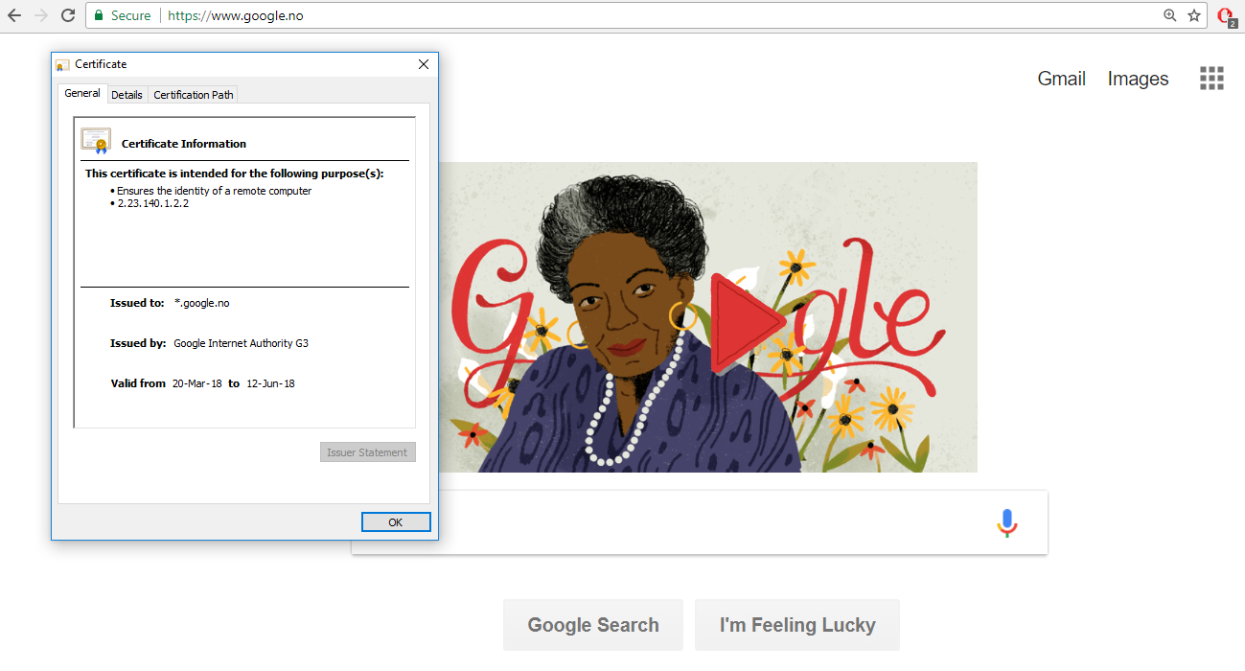

Slide 9
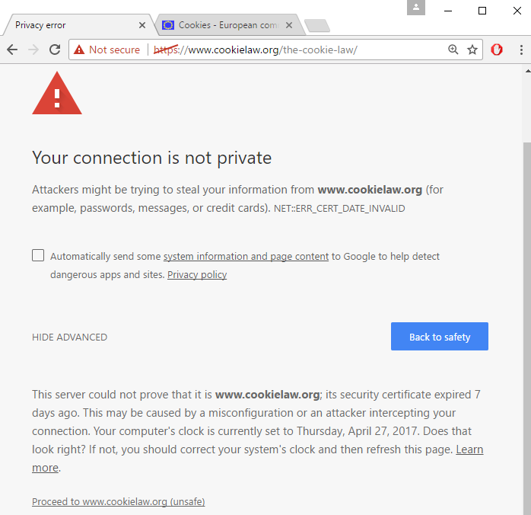
What if browser detects that the certificate is invalid?

Slide 10
If Certification Fails
2 main possibilities
1) Expired certificate: developers have not renewed their certificates with the CA
2) Man-in-the-middle attack
Trying to pretend to be the web app you want to connect to, so can steal your login/password, eg by serving a fake login page that is equal to the original one
Easy way to do such attack? Use a router, have an open WiFi called “Free WiFi”, go close to a bar/restaurant, and wait for people to connect to it, give them fake pages with fake certificates, and wait for those people to click “Proceed” when browser complains about certificate is invalid
NEVER PRESS “PROCEED” WITH INVALID CERTIFICATE ON UNTRUSTED NETWORK!!! And if you really have to, do not provide any sensitive information, eg passwords, although it would be still a problem with cookies…

Slide 11
Login

Slide 12
Authentication/Authorization
Authentication:
do I know who a user X is?
how to distinguish X from a different user Y?
Authorization:
once I know that the current user is X, what is X allowed to do?
can s/he delete data?
can s/he see data of other users?
etc.
Of course, they only make sense with encryption (eg HTTPS), so no one can decode and tamper with the messages…

Slide 13
Authentication/Authorization failures
If not authenticated, server can:
redirect to login page, HTTP status code 3xx
error page, HTTP status 401 Unauthorized
If authenticated but not authorized
eg user X tries to access data of Y
3xx redirection
HTTP status 403 Forbidden

Slide 14
Blacklisting vs Whitelisting
Authorization is done on the server, and will depend on the language/framework
JEE, Spring, PHP, .Net, NodeJS, etc.
user will just get either a 3xx or 403 response
Blacklisting: everything is allowed by default. What is not allowed for a given user/group has to be explicitly stated
Usually not a good idea, as easy to forget to blacklist some critical operation
Whitelisting: nothing is allowed by default. What is allowed has to be explicitly stated
“forgetting to allow something” (reduced functionality) is much, much better than “forgetting to forbid something” (security problem)

Slide 15
Authentication: first steps
Server does not know who the user is
Server only sees incoming HTTP/S messages
not necessarily from a browser… user can do direct TCP connections from scripts
HTTP/S is stateless
Need a way to tell that sequence of HTTP/S calls come from same user
User has to send information of who s/he is at EACH HTTP/S call
But users can lie… (eg, hackers)

Slide 16
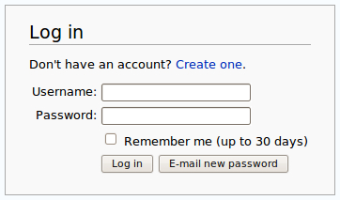
Ids and Passwords
A user will be registered with a unique id
Need also secret password to login
Otherwise anyone could login with the ids of other users…
HTTP/S does not prevent attempts to login to accounts of other users

Slide 17
How to implement a login mechanism?
When talking about security and what to implement on the server, think about HTTP/S messages, not necessarily coming from browsers.
Could have endpoint to get token from server given userId/password
Use such token on each following request as parameter
GET /login?userId=x&password=y
userId/password as URL parameters to the /login endpoint
get back new token Z associated to this user, as HTTP/S response body, no HTML page
GET /somePageIWantToBrowse?token=z
pass “token=z” parameter to each HTTP/S request

Slide 18
Awful Solution
That solution would work, but…
“/login?userId=x&password=y” would be cached in your browser history, even after you logout
How to handle the adding of “?token=z” to all your <a> tags in the HTML pages?
doable, but quite cumbersome
How to handle browser bookmarks?
tokens would be there, and made the links useless once they expire, eg after a logout

Slide 19
POST and Cookies
User ids and passwords should never be sent with a GET
GET specs do not allow body in the requests
Should be in HTTP body of a POST
This is typical case in HTML forms
Authentication “tokens” should not be in URLs, but in the HTTP Headers
Cookie: special header that will be used to identify the user
The user does not choose the cookie, it is the server that assigns them
Recall: user can craft its own HTTP messages, so server needs to know if cookie values are valid

Slide 20
Login with Cookies
Browser: POST /login
Username X and password as HTTP body
Server: if login is successful, respond to the POST with a “Set-Cookie” header, with some unique and non-predictable identifier Y
Server needs to remember that cookie Y is associated with user X
Set-Cookie: <cookie-name>=<cookie-value>
Browser: from now on, each following HTTP request will have “Cookie: Y” in the headers
Logout: remove association between cookie Y and user X on server.
Server: HTTP request with no cookie or invalid/expired cookie, do 3xx redirect to login page

Slide 21
Request Login page
GET /login.html
POST /login.html
username=foo&password=bar
Send credentials by submitting the form
Validate the credentials. If correct, create a session, identified by a cookie id
HTTP/1.1 302
Set-cookie: 123456
Location: /index.html
Automatically follow the 302 redirection, and add cookie header in all following requests
GET /index.html
Cookie: 123456

Slide 22
Cookies and Sessions
Servers would usually send a “Set-Cookie” regardless of login
want to know if requests are coming from same user, regardless if s/he is registered/authenticated
ie cookies used to define “sessions”
After login could create a new session (ie, invalidate old cookie and create a new one) or use the existing session cookie (eg, the one set by the server when login page was retrieved with the first GET)
Problem with re-using session cookies: make sure all the pages were served with HTTPS and not HTTP
Ie, use HTTPS for all pages, even the login one
do not use HTTP and then switch to HTTPS once login is done

Slide 23
Storing cookies
The browser will store cookie values locally
At each HTTP/S request, it will send the cookies in the HTTP headers
Cookies are sent only to same server who asked to set them
eg, cookies set from “foo.com” are not going to be sent when I do GET requests to “bar.org”
JavaScript can read those cookie values on the browser
What is the problem with it?
You can fabricate a web site with JS that reads all cookies, and send them back to you, so that you can use them to access the user’s Google/Facebook/Bank accounts
As cookies are arbitrary strings, they can be used to store data
usually up to 4K bytes per domain can be stored in a browser

Slide 24
Expires / Secure / HttpOnly
Set-Cookie: <name>=<value>; Expires=<date>; Secure; HttpOnly
Expires: for how long the cookie should be stored
Secure: browser should send the cookie only over HTTPS, and NEVER on HTTP
There are kinds of attacks to trick a page to make a HTTP toward the same server instead of HTTPS, and so could read authentication cookies in plain text on the network
HttpOnly: do not allow JS in the browser to read such cookie
This is critical for authentication cookies

Slide 25
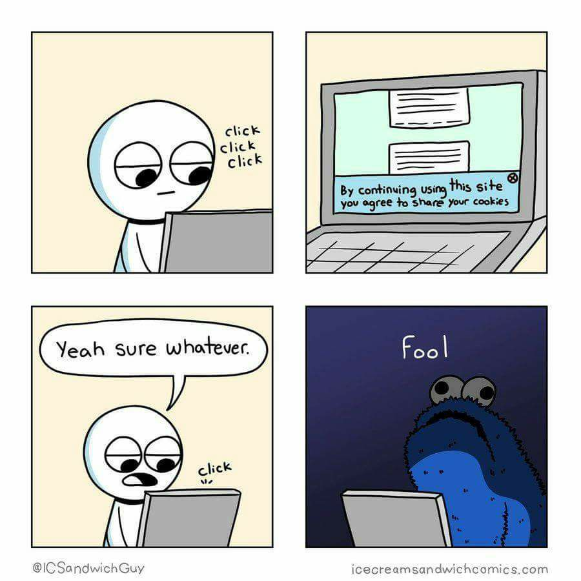
Cookie Tracking
Besides session/login cookies that have an expiration date, server can setup further cookies (ie Set-Cookie header)
There are special laws regarding handling of cookies
Why? Tracking and privacy concerns…

Slide 26
Tracking
Many sites might rely on resources provided by other sites
Images, JavaScript files, CSS files, etc.
eg, Facebook “Like” button
When you download a HTML page from domain X (eg finn.no) which uses a resource from Y (eg, facebook.com), the HTTP GET request for Y will include previous cookies from Y
So, even if you are logged out from Facebook, FB can know which pages you visit (as long as they do use FB resources), as can have permanent cookies stored on your browser and not related to a current session on FB
Even worse, FB can track your browser even if you have never used FB!!!
This happens by simply opening the page from X, no need to click anything!!!
referer HTTP header: domain origin of request to Y from page not from Y
Eg, “Referer: X” is added when page loaded from X ask for resource in Y

Slide 27
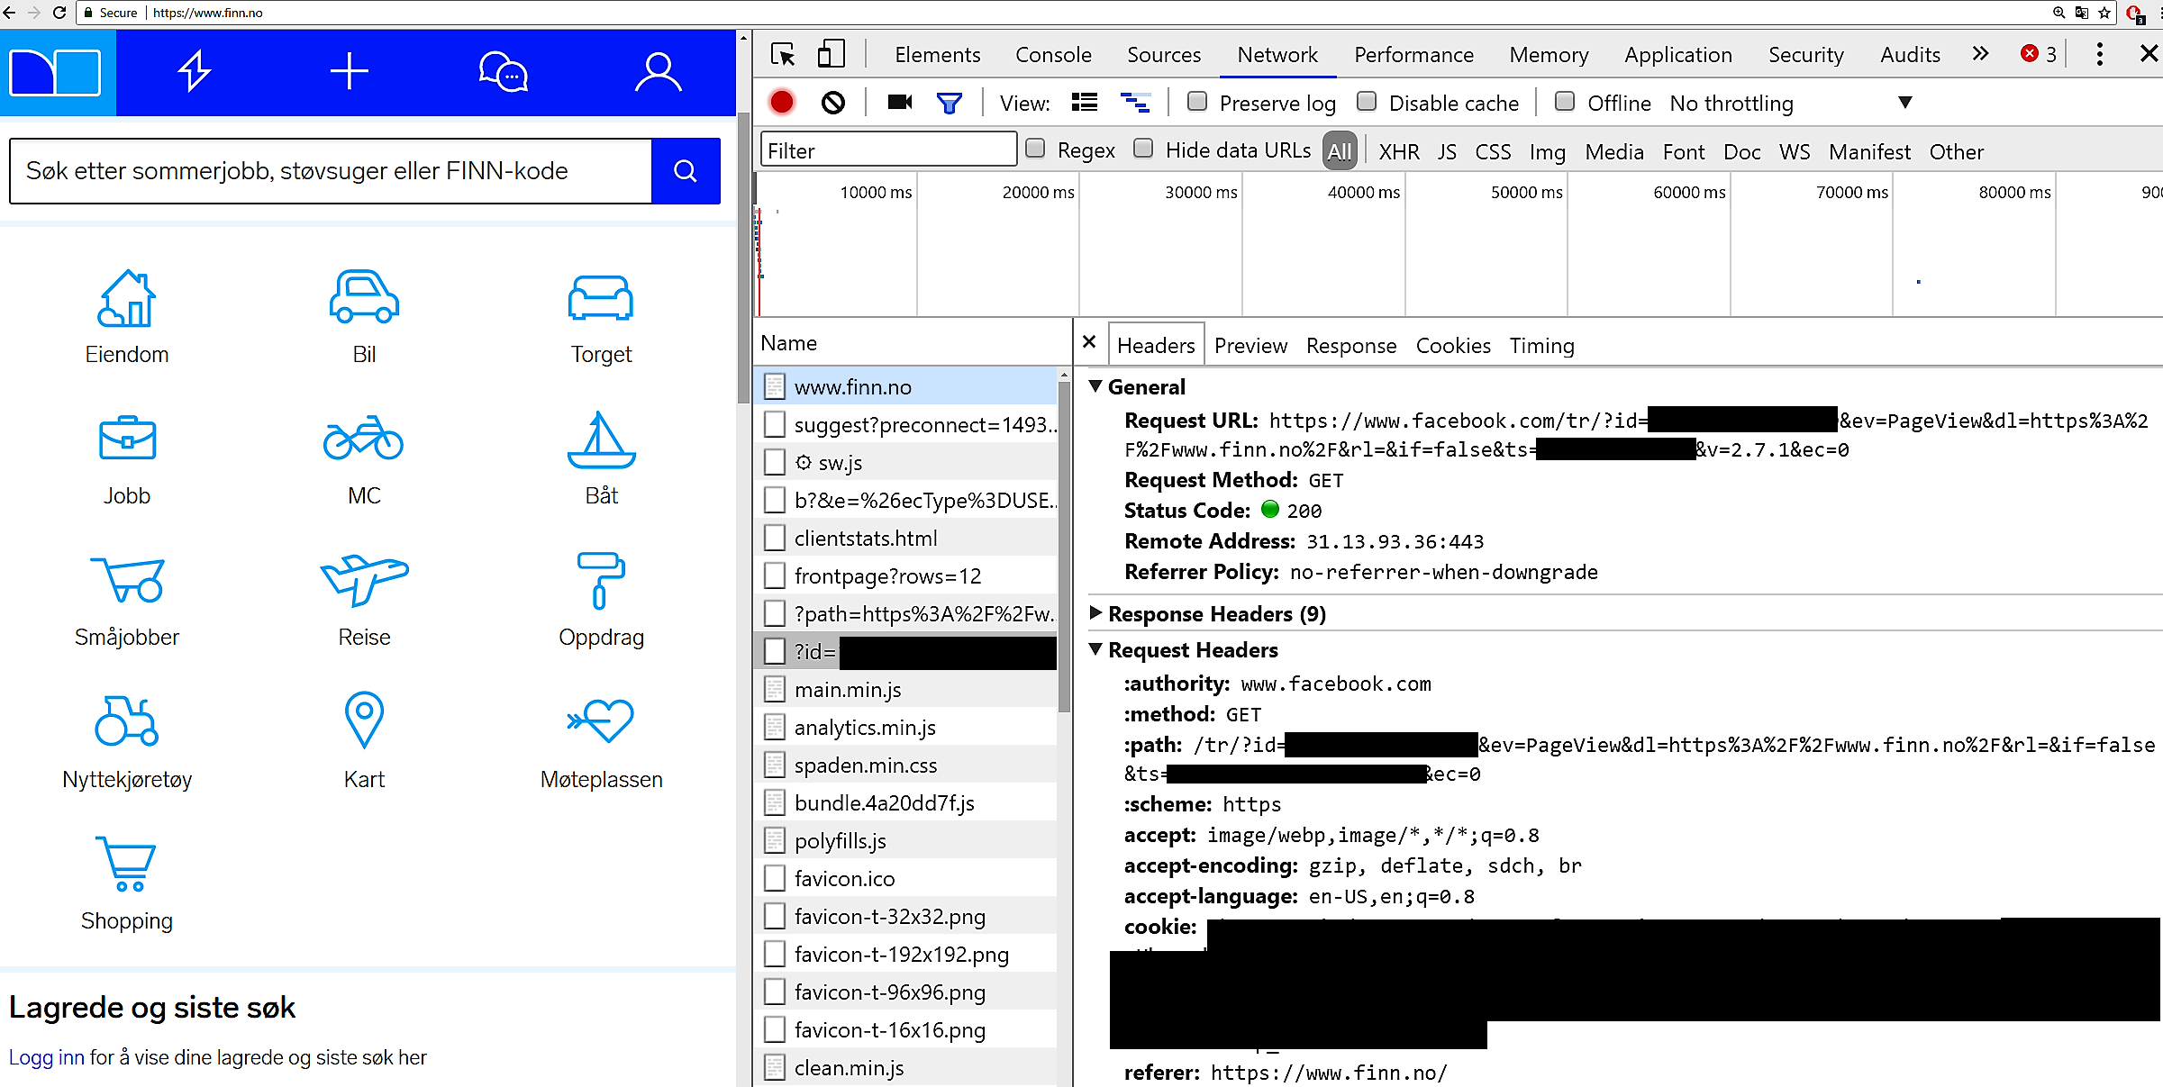
Note: this was in 2017, might have been removed/changed by now on Finn

Slide 28
CSRF and CORS

Slide 29
AJAX and Cookies
When browser requests resource for “foo.com”, all cookies set by that domain are sent in the headers, session ones included
This applies also to AJAX requests made with XMLHttpRequest
Do you see the problem here?
Cross-Site Request Forgery (CSRF) attack

Slide 30


Login to dnb.no
Set-cookie: dnb=123
www.dnb.no
Example of CSRF attack
Malicious AJAX POST
Cookie: dnb=123
Transfer all money to Eve
Visit malicious site, with malicious JavaScript automatically run on page load
www.evil.no

Slide 31
Cross-Origin Resource Sharing (CORS)
By default, browsers will allow only AJAX calls toward the same domain (ip:port) of where the JS was downloaded from
eg, JS downloaded from evil.no can only do AJAX towards evil.no
Access-Control-Allow-Origin: special HTTP header set by server to allow requests from other origins/servers
“Access-Control-Allow-Origin: foo.com” allow only from “foo.com”
“Access-Control-Allow-Origin: *” allow from anywhere (not really secure at all…)
Origin: special HTTP header, set by browser when making request, specifying origin of the JS

Slide 32
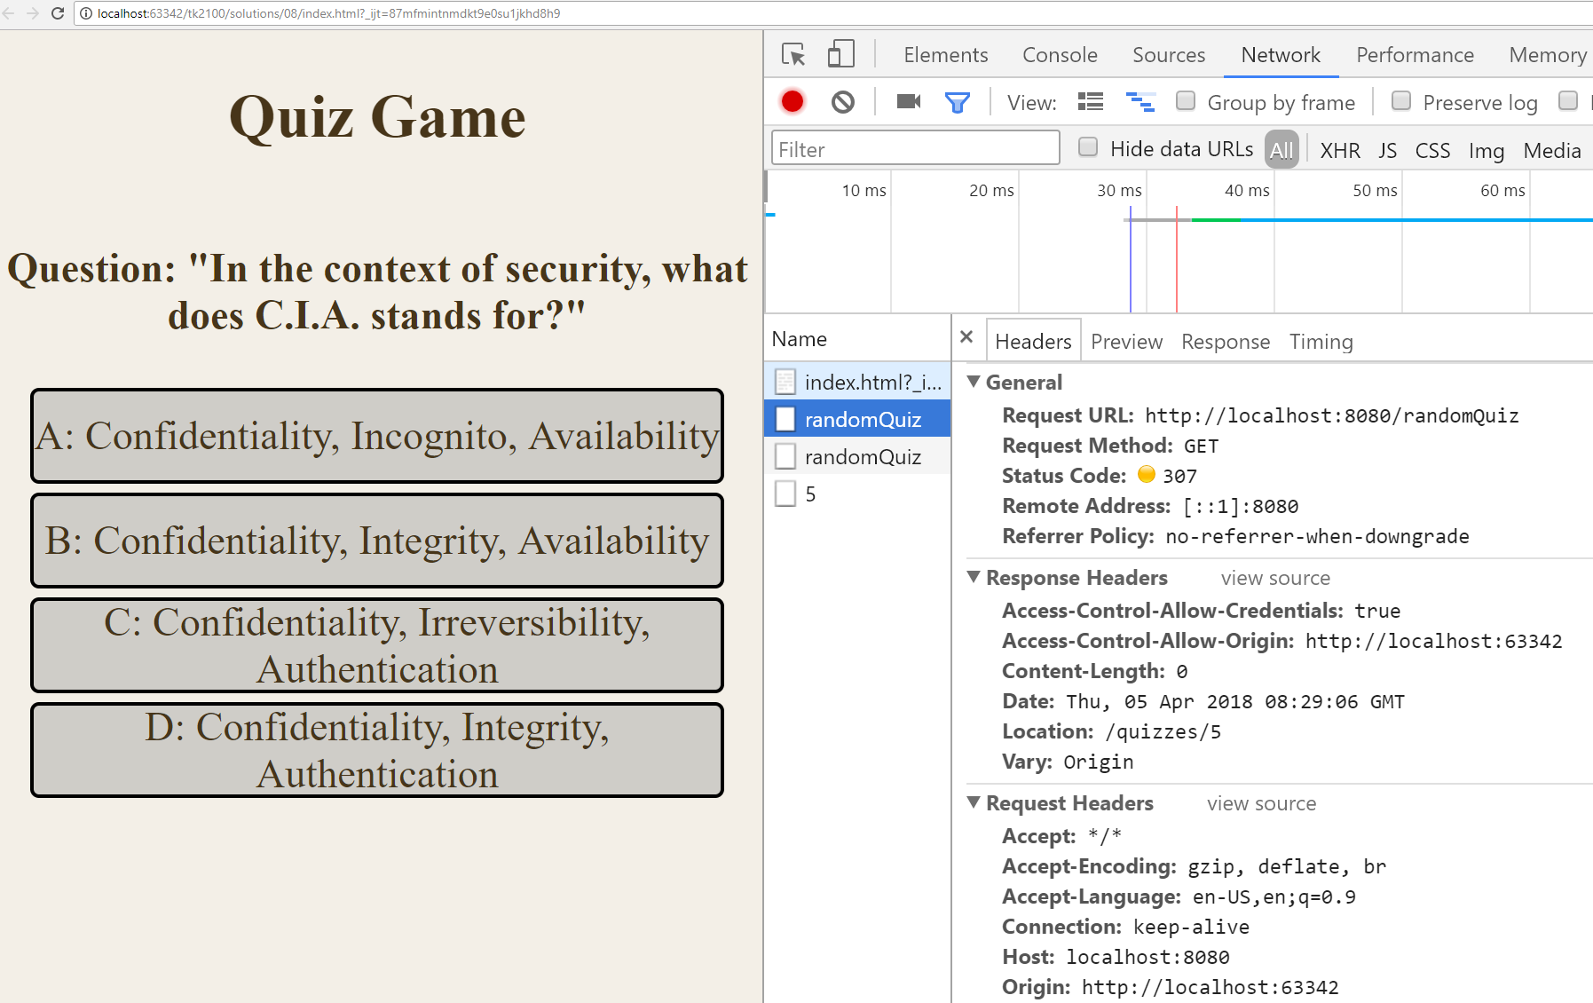

Slide 33
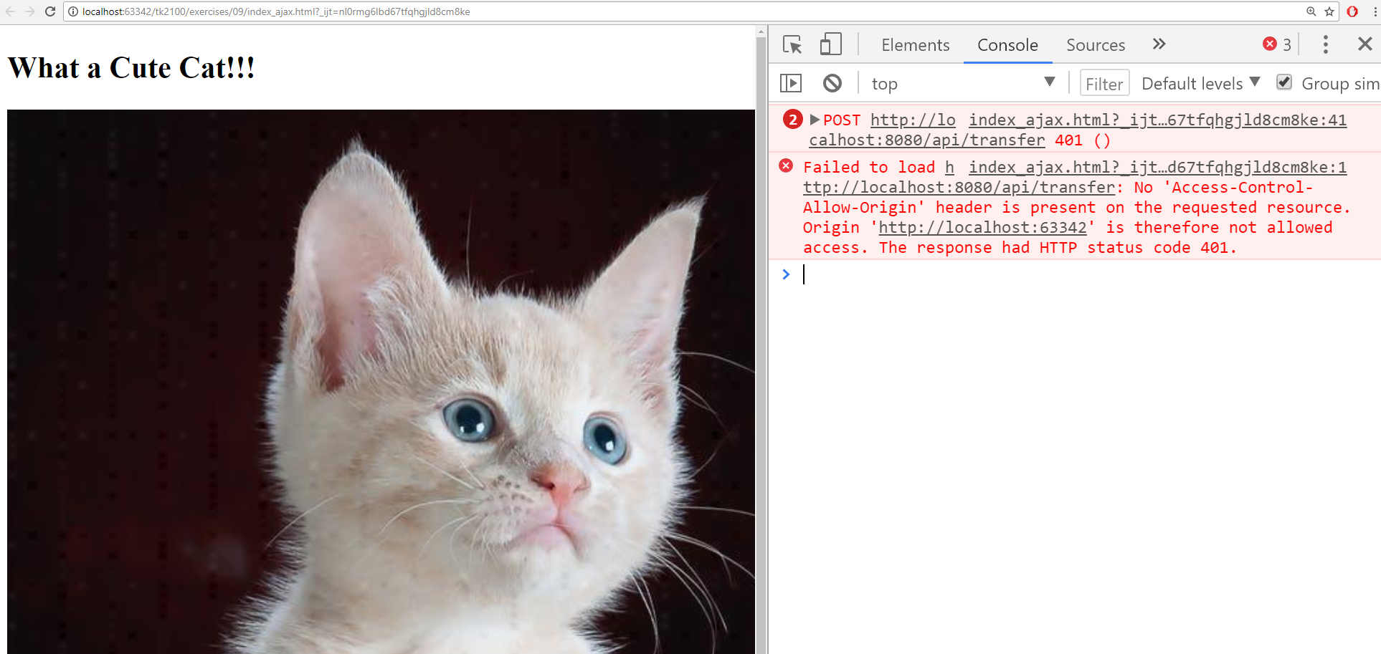
Malicious page trying AJAX call toward your bank
CORS will block the AJAX call… can see the error message in the Console

Slide 34
CORS Not Enough
CORS can prevent malicious AJAX, but AJAX is not the only way to do HTTP calls in a browser…
What about if Eve creates page with malicious HTML form toward a bank?
<form name=“evilForm"
action="http://dnb.no/transferMoney"
method="POST"> <input name="to" value="eve"> <input name="amount" value="1000"> </form>

Slide 35
Two Problems for Eve
How to trick the user to click on the form to submit it?
How to hide the fact that there is such malicious form in the HTML page so that the user has no idea of what is going on?

Slide 36
Can submit forms with JS…
document.forms[“evilForm”].submit();
Can execute it once page is loaded… d’oh!!!

Slide 37
CSS Hiding
“display:none”
can use CSS to hide the presence of HTML elements in the page…
<iframe id="invisibleFrame" name="invisibleFrame" style="display:none"></iframe>
<form … target="invisibleFrame“>
can redirect output/result of the HTTP POST to an invisible frame

Slide 38
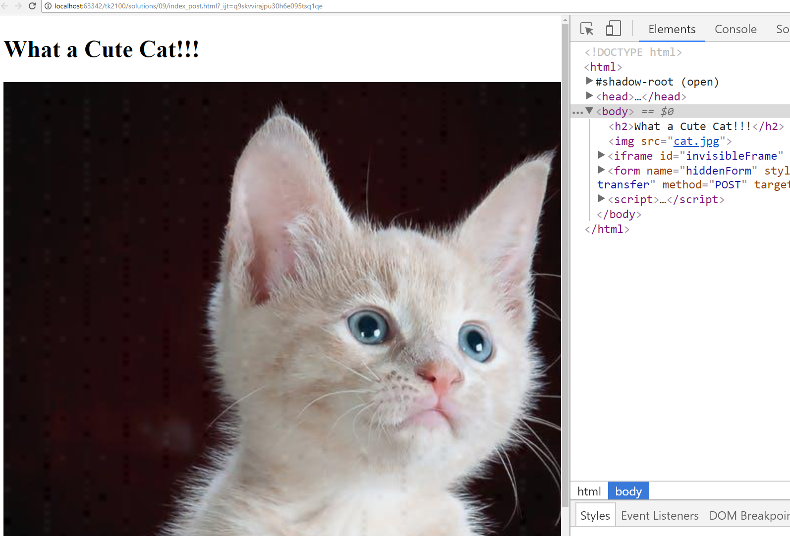
Example of malicious page with hidden form
Automatically submit the hidden form with JavaScript.. CORS is not going to help you here…

Slide 39
CSRF Prevention
Using a cookie token for authentication is not enough for critical operations
Need a second token which is NOT stored in a cookie, and added in the HTML/JS at each request
Server will validate both tokens before accepting a request
Details on how to handle such token depends on the framework used by the server, and how it generates the HTML pages
eg, added as a secret, non-visible input in the HTML forms
Eve will/should not be able to read and use such second token

Slide 40
For Next Week
Book pages: 334-338, 342-348, 356, 364-367
Note: when I tell you to study some specific pages in the book, it would be good if you also read the other pages in the same chapter at least once
Exercises for Lesson 9 on GitHub repository

